Slide 1
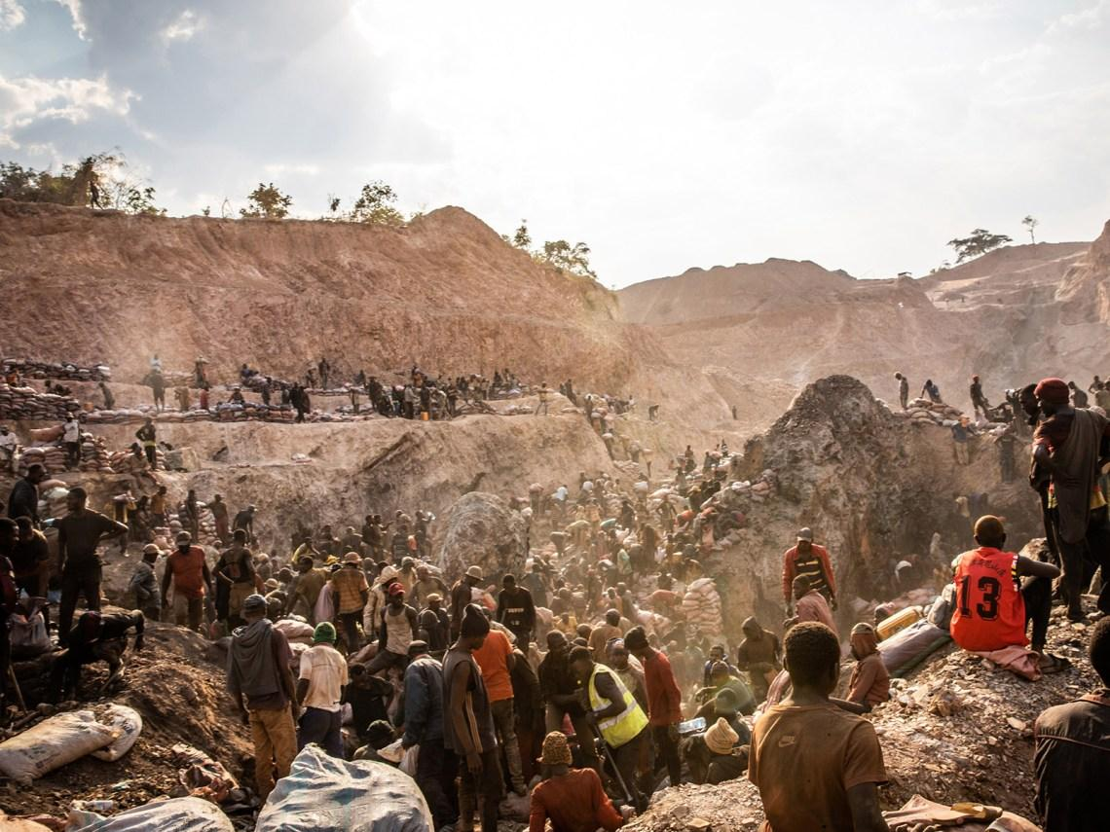
COBALT MINING IN CONGO

Slide 2
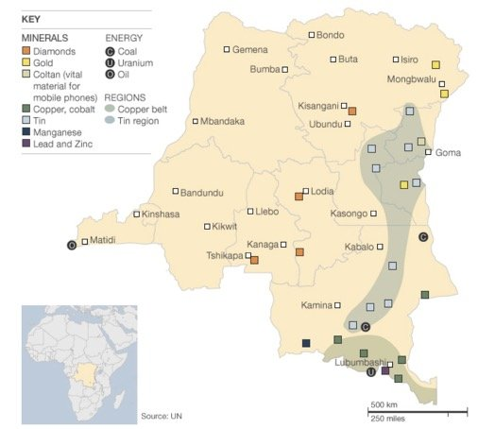
COBALT
Cobalt, essential for lithium-ion batteries in smartphones, laptops, and electric vehicles, is primarily sourced from the Democratic Republic of Congo, which holds about 50% of global reserves and produces around 70% of the world's supply.

Slide 3
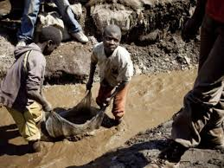
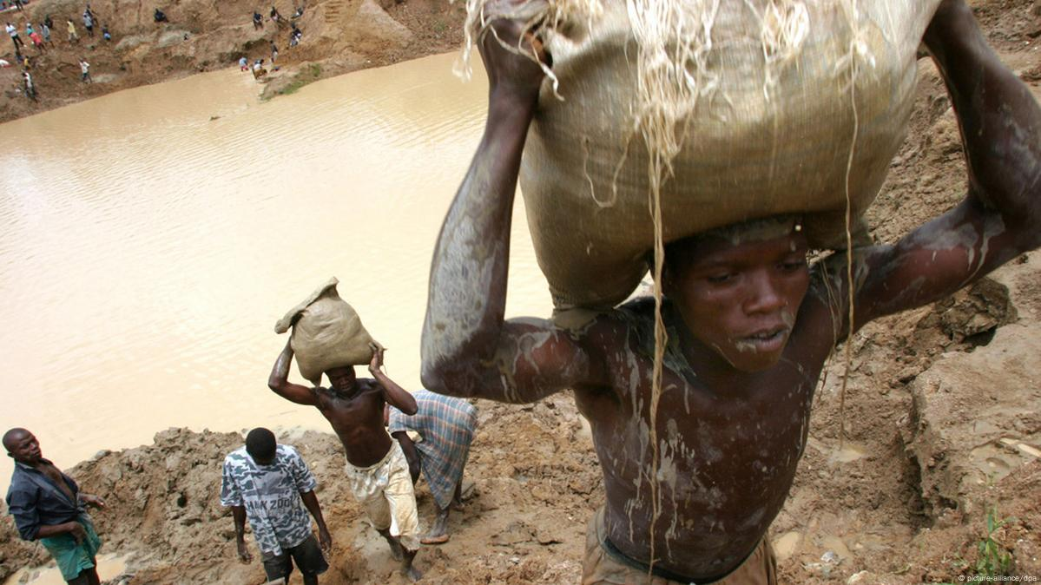
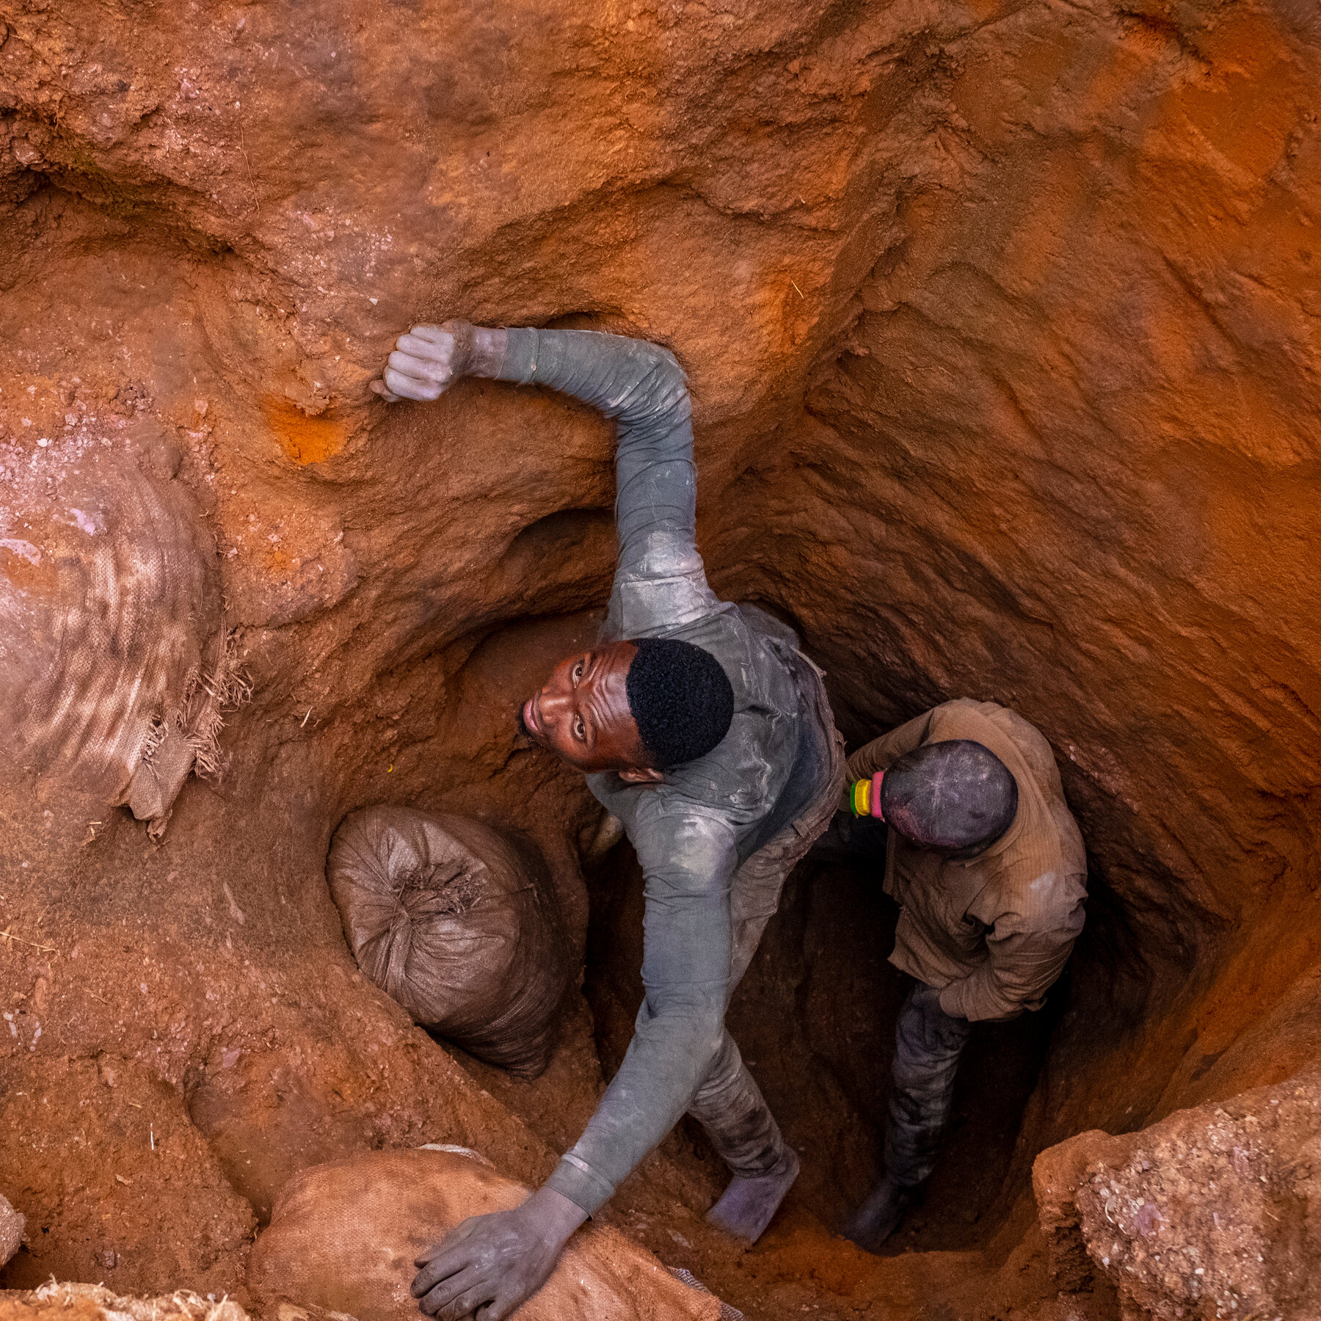
CHILD LABOR & COBALT
In 2014, an estimated 40,000 children worked in DRC mines (~40% workers)
Child miners often labor up to 12 hours a day hauling heavy ore for as little as $1–$2 USD per day.
Children working in mines face dangerous conditions - including tunnel collapses, exposure to toxic substances, and lack of protective equipment

Slide 4
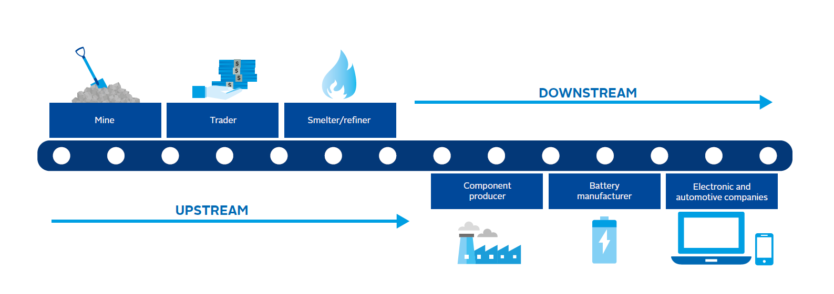
MINING IN DRC
TRANSPORTED TO REFINERIES (CHINA)
REFINED INTO COBALT
MANUFACTURED INTO BATTERIES
SUPPLY
CHAIN

Slide 5
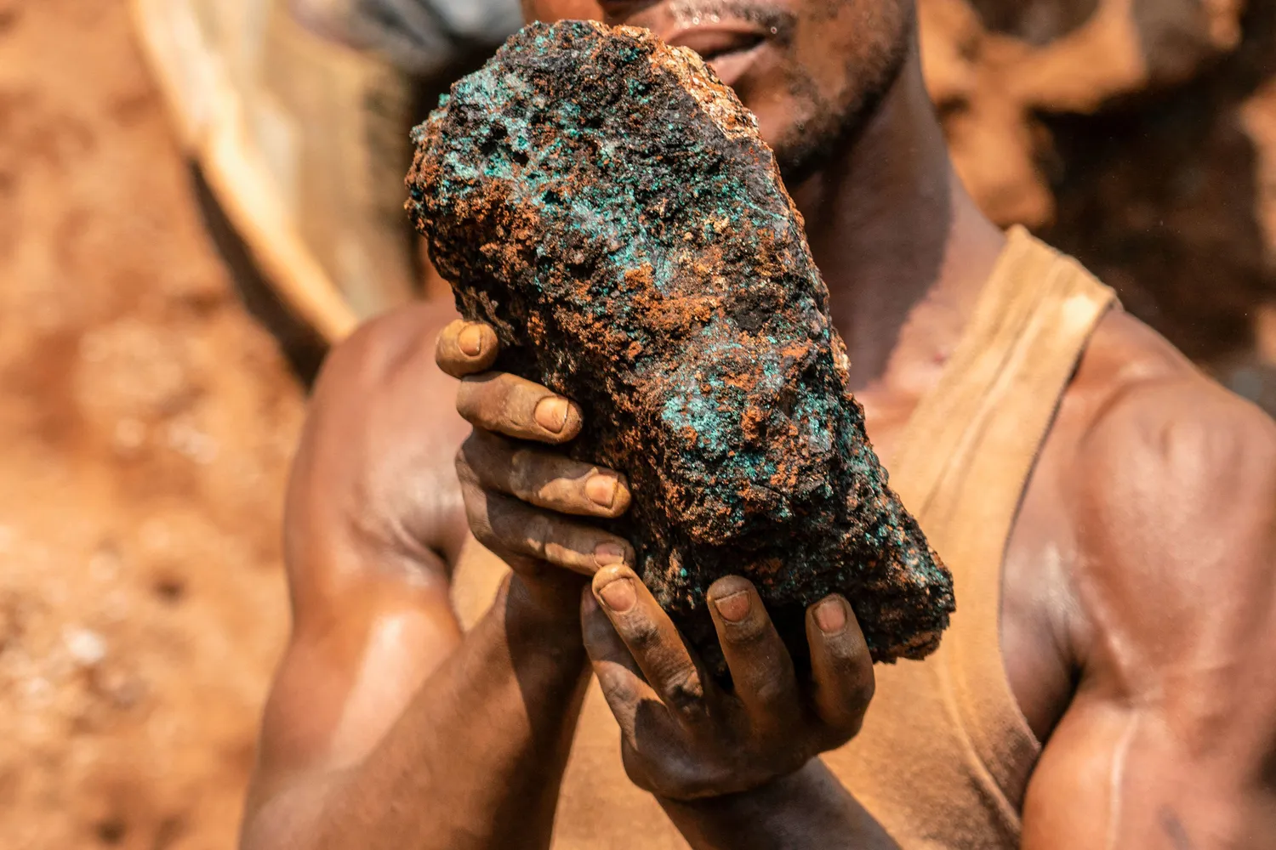
EXPLORE: FIND COBALT DEPOSITS
MINE: INDUSTRIAL COMPANIES & ARTISANAL MINERS
CRUSHED, WASHED & PROCESSED ORE LOCALLY
TRANSPORTATION: RAW COBALT INTO PORTS
EXPORTATION: EX: CHINA TO FULLY REFINE
PRODUCING THE PRODUCT

Slide 6
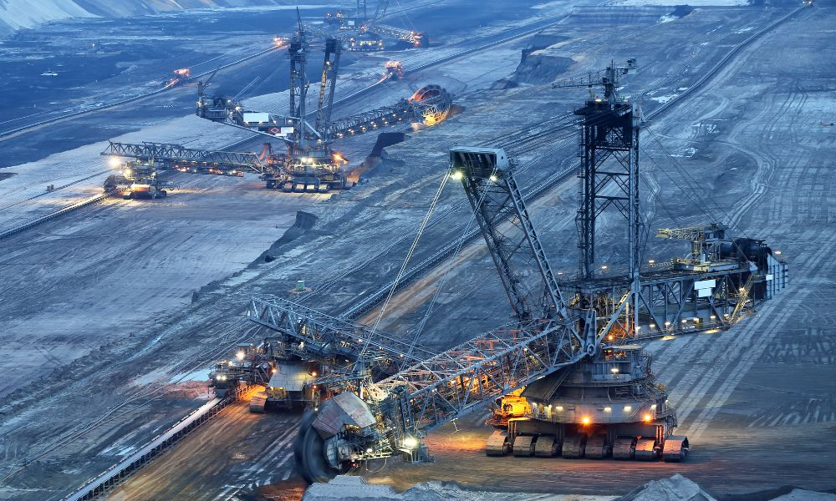
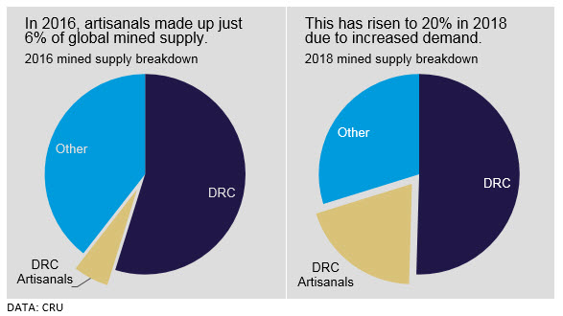
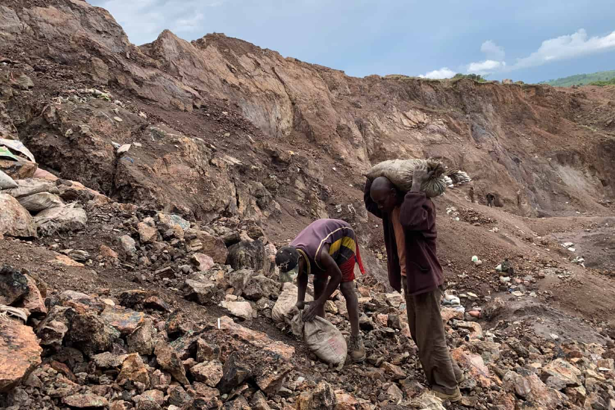
Why hasn't cobalt mining become skilled, highly automated work like other mining?
Physical: Cobalt veins are very scattered making heavy equipment less practical
Economic: Extreme poverty means human labor is incredibly cheap, often cheaper than maintaining equipment.
Regulatory: Buying cobalt from artisanal mines helps companies avoid environmental regulations and offers plausible deniability for labor abuses.
Political: Heavy equipment would be a prime target for theft and sabotage groups due to weak political institutions in the DRC
ARTISANAL MINES

Slide 7
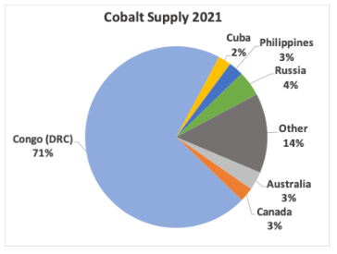
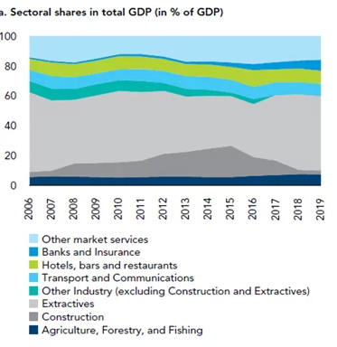
ECONOMICS
Extractives (mining) account for more than half of congolese GDP
The Congo controls over 70% of the global cobalt production
In 2023, the DRC exported about $2.4 billion worth of cobalt
Demand for the material is expected to explode due to battery demand

Slide 8
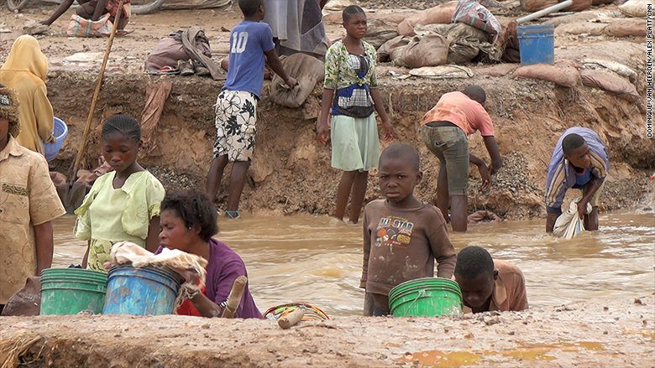
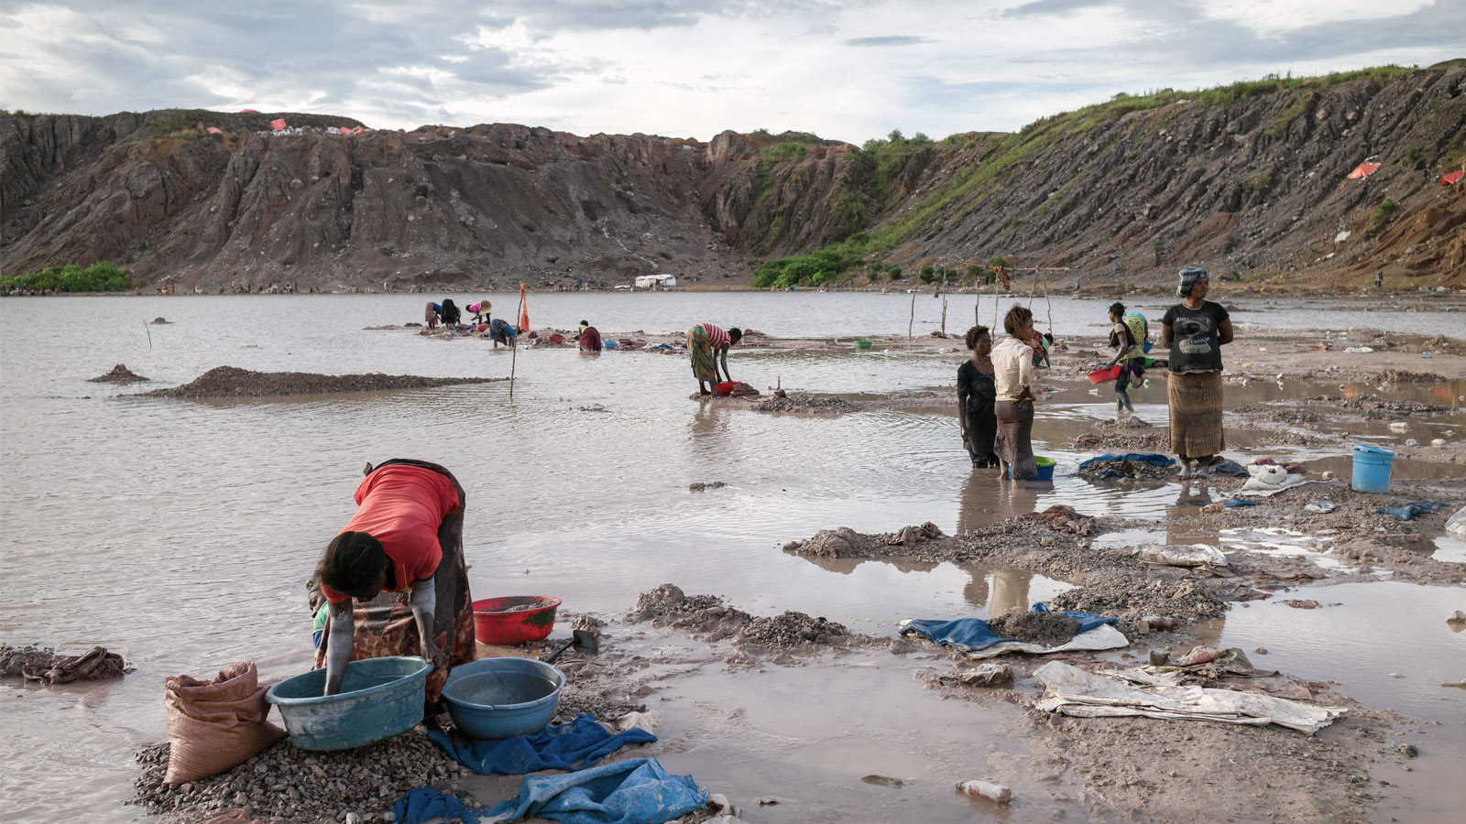
BROAD EFFECTS
Many families are so poor that children need to work. As a consequence, only about 69% of children (age 5–14) attend school in the congo
In 2019, the DRC government (under President Tshisekedi) renewed efforts to enforce free primary education
There has been an effort to form “catch up clubs” to rapidly educate former child laborers

Slide 9
COMPANIES LIKE APPLE, TESLA & MICROSOFT PLEDGED TO SOURCE “ETHICALLY MINED” COBALT.
THE DRC GOVERNMENT ANNOUNCED REGULATIONS AND WORKED WITH ORGANIZATIONS TO ADDRESS CHILD LABOR.
REGULATE & RESTRICT
CERTIFICATION PROGRAMS EXIST, BUT DO NOT COVER MANY SITES
ILLEGAL MINING + POVERTY = WIDESPREAD CHILD LABOR THAT STILL REMAINS…

Slide 10

GLOBAL IMPACT
BIG GLOBAL DEMANDS = CHEAP & FAST COBALT MINING
MULTI-LAYERED SUPPLY CHAINS = HIDDEN LABOR ABUSES
DRC RELIES ON EXPORTS = AVOIDANCE OF STRICT REFORMS

Slide 11
GLOBALISM X REFORM
BIG GLOBAL DEMAND
SOURCING AT THE LOWEST COSTS
PROFIT OVER HUMAN RIGHTS
CONSUMERS ARE DISTANT FROM THE PROBLEM. LESS PUBLIC PRESSURE = NO COMPANY CHANGE!

Slide 12
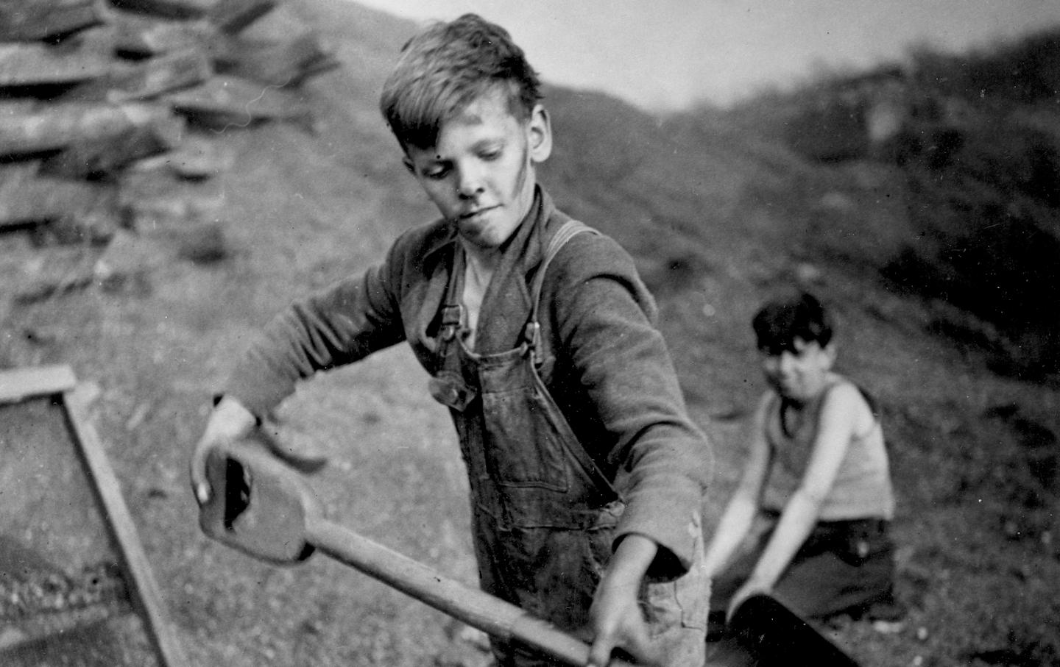
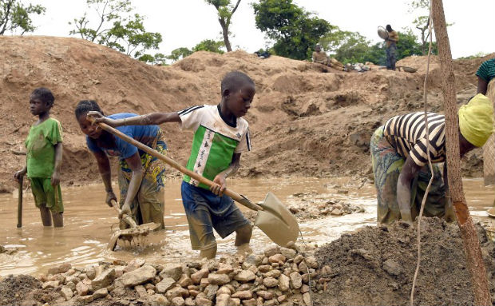
COMPARISON TO US
Very similar to 19th and early 20th century child labor in US mines
Congolese cobalt mining fits Hindman’s definition perfectly: It is extremely detrimental to the children's wellbeing
Both situations have all elements recognized by Hindman: extreme poverty, high demand for unskilled labor (cobalt veins are small & scattered making manual mining economical), and lack of educational opportunities

Slide 13
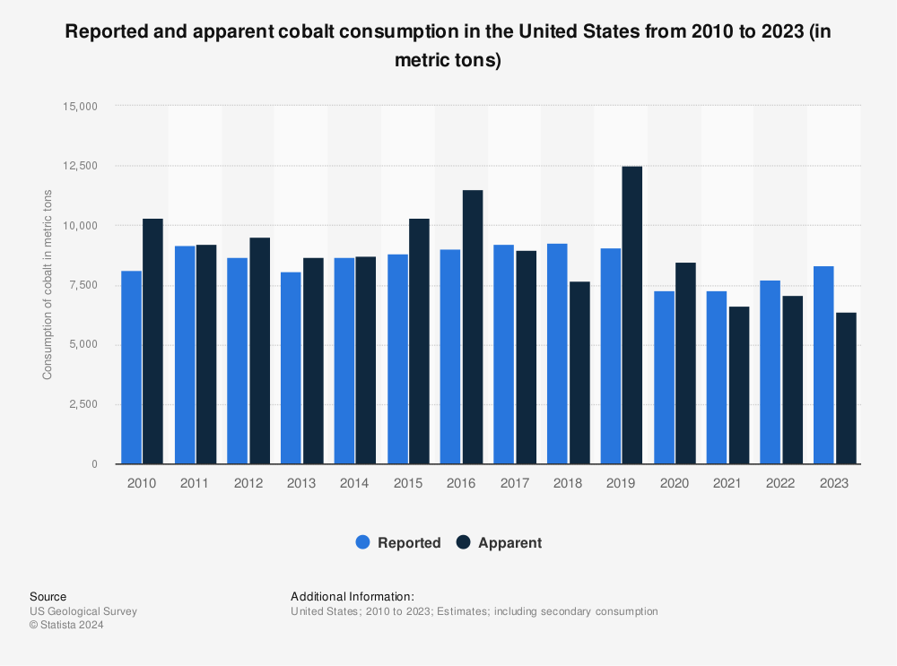
SUPPORT ETHICAL BRANDS!
ASK QUESTIONS & SIGN PETITIONS!
BUY LESS ELECTRONIC STUFF & USE THEM LONGER!
EDUCATE THOSE AROUND YOU ABOUT CHILD LABOR IN MINING!
CONSUMERS!
CONSUMERS!
CONSUMERS!

Slide 14
RELATION TO HINDMAN
Hindman defines harmful child labor as work that is dangerous and harmful to children, namely work that:
Deprives children of their education: Mining prevents many children from attending school, trapping them in a cycle of poverty​
Endangers their health: Cobalt itself is toxic, and the mines children work in are prone to collapse
Exploits their poverty​: Families are desperate for income, and Manual mining persists due to economic necessity

Slide 15
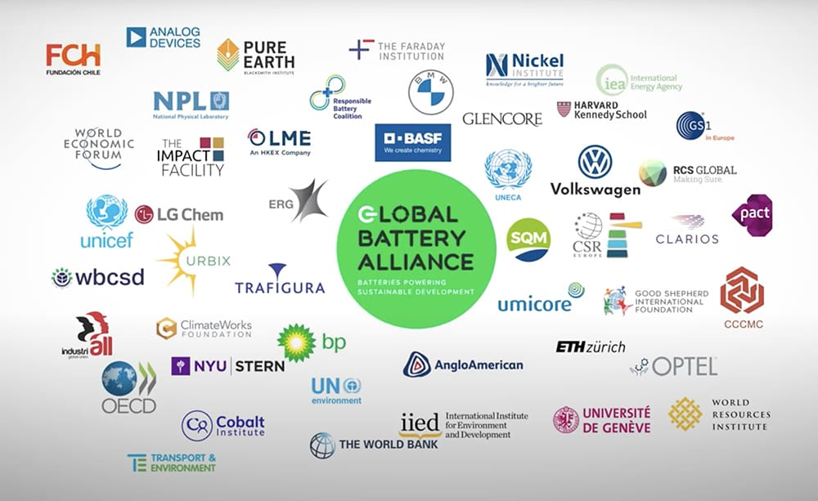
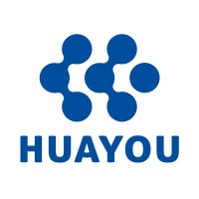
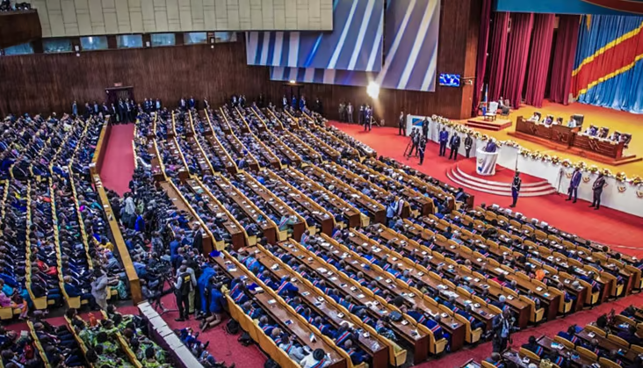
REGULATION EFFORTS
The DRC has laws prohibiting child labor, especially in mines. The Labor Code and Child Protection Code set 18 as the minimum age for work​. To enforce these laws, the DRC has recently increased the number of labor inspectors and created the Inter-ministerial Commission on Child Labor in Mines
Consumer pressure: Huayou Cobalt (China’s largest cobalt refiner) announced it would stop buying cobalt from unregulated artisanal miners; automakers like Tesla, BMW, and Ford joined the Global Battery Alliance, pledging to develop battery supply chains free of child labor

Slide 16
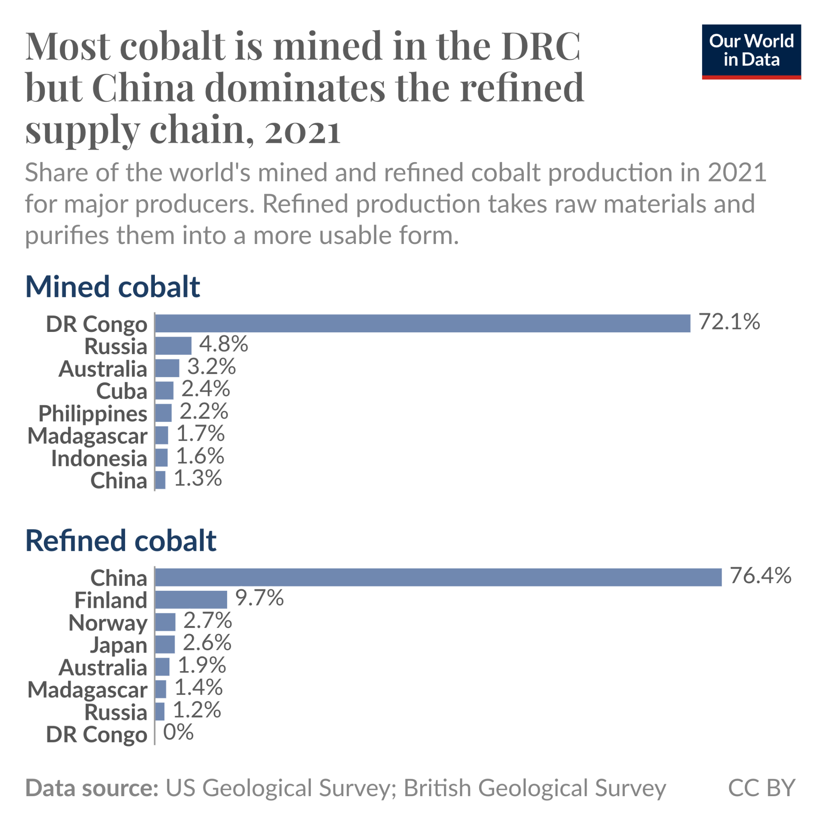
CHINA'S ROLE
Chinese firms have heavily invested in DRC mining. 8 of the 14 largest cobalt mines in the DRC are Chinese-owned, and overall Chinese entities control ~50–80% of DRC cobalt production​
Much of DRC’s raw cobalt is purchased by China’s state-owned companies, refined in China, and then sold worldwide​

Slide 17
REFERENCES
https://www.cecc.gov/events/hearings/from-cobalt-to-cars-how-china-exploits-child-and-forced-labor-in-the-congo
https://www.dol.gov/agencies/ilab/combatting-child-labor-democratic-republic-congos-cobalt-industry-cotecco
https://www.npr.org/sections/goatsandsoda/2023/02/01/1152893248/red-cobalt-congo-drc-mining-siddharth-kara
https://earth.org/cobalt-mining/
https://e360.yale.edu/features/siddharth-kara-cobalt-mining-labor-congo
https://theconversation.com/drc-is-the-worlds-largest-producer-of-cobalt-how-control-by-local-elites-can-shape-the-global-battery-industry-236205
https://www.congress.gov/event/118th-congress/joint-event/LC72512/text
https://www.dol.gov/agencies/ilab/combatting-child-labor-democratic-republic-congos-cobalt-industry-cotecco
https://www.amnesty.org/en/latest/news/2016/01/child-labour-behind-smart-phone-and-electric-car-batteries/
https://www.npr.org/sections/goatsandsoda/2023/02/01/1152893248/red-cobalt-congo-drc-mining-siddharth-kara
https://www.amnesty.org/en/latest/news/2023/09/drc-cobalt-and-copper-mining-for-batteries-leading-to-human-rights-abuses/

